Slide 1

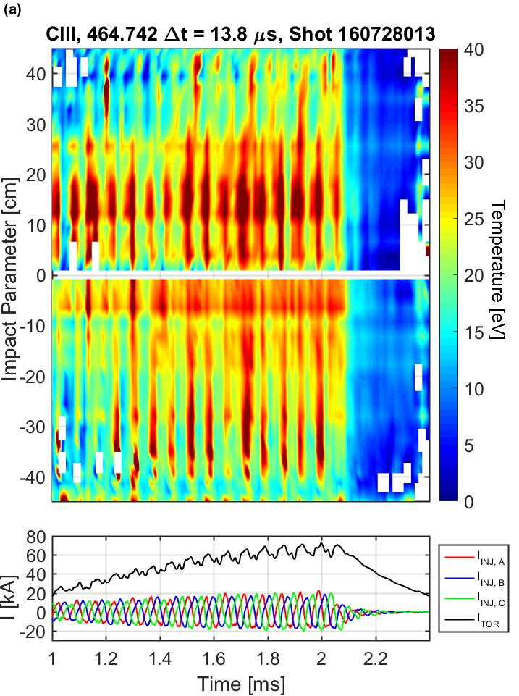
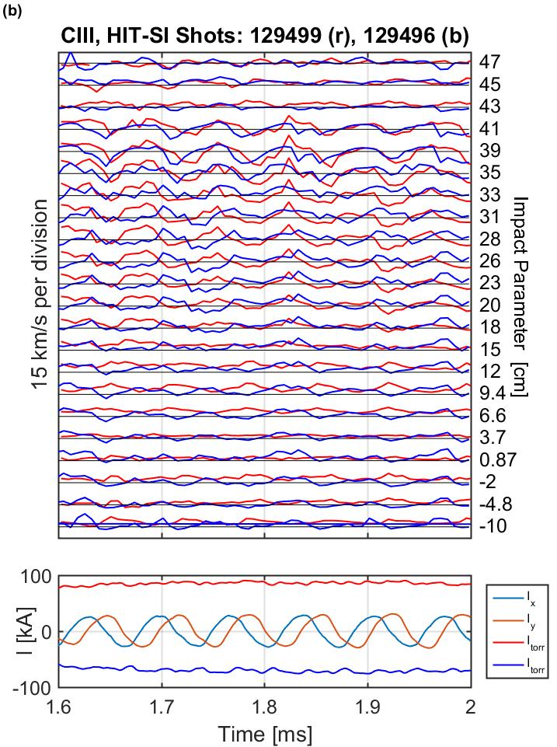
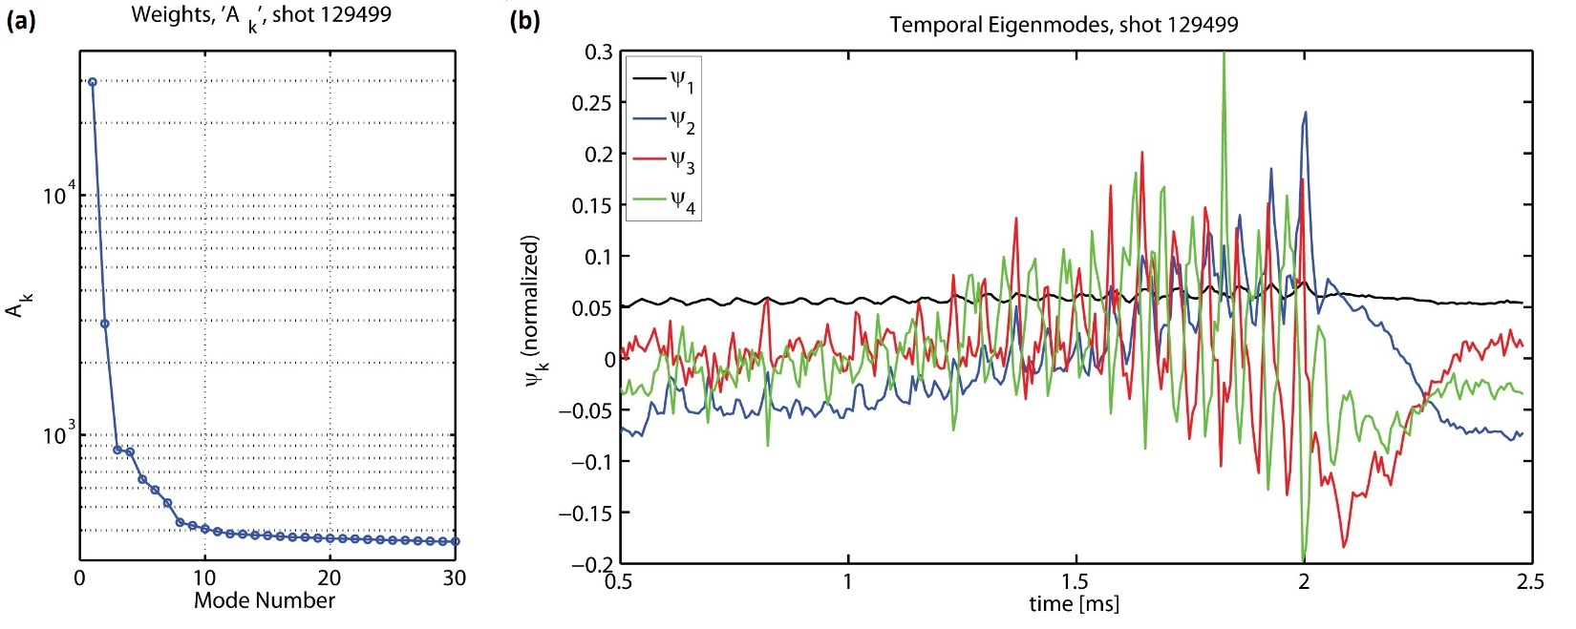
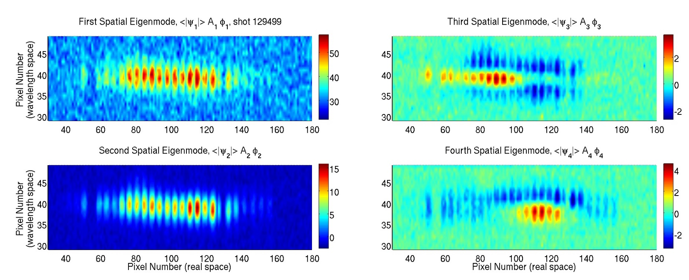
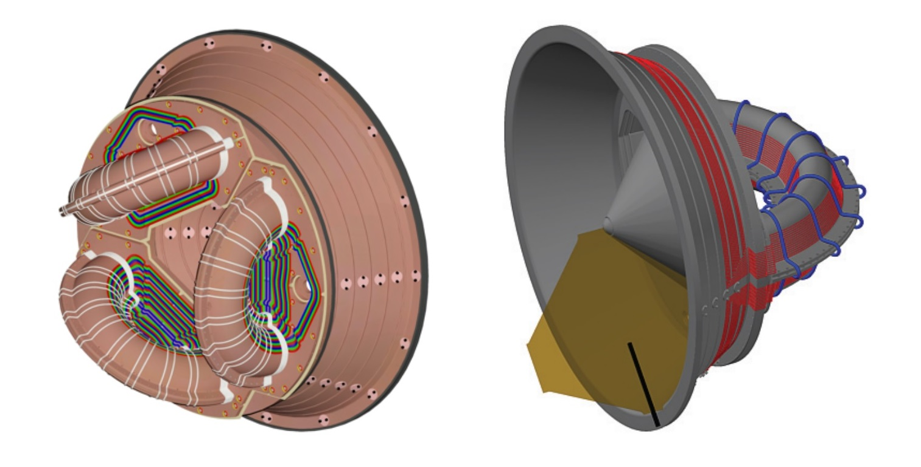
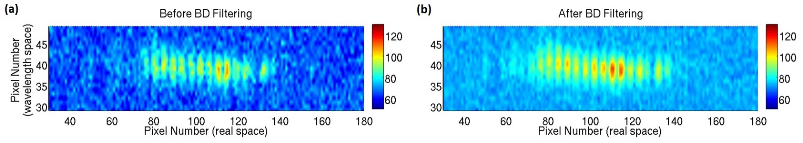
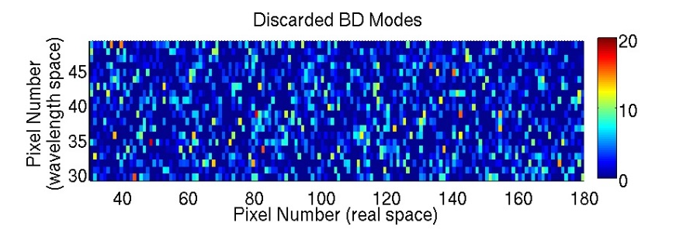
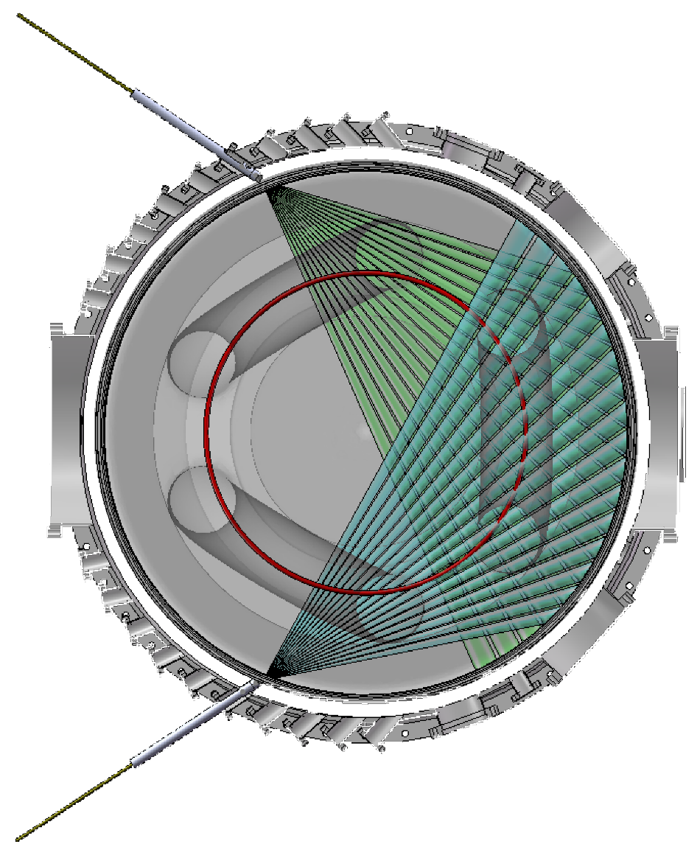
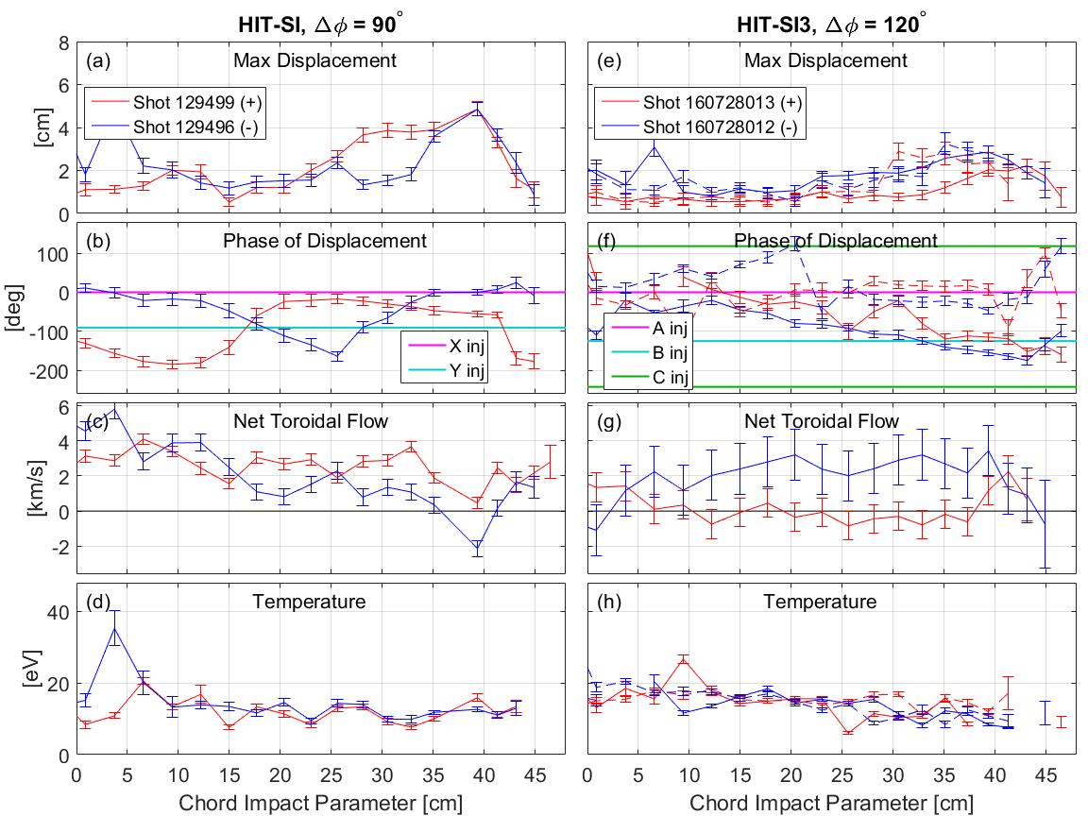
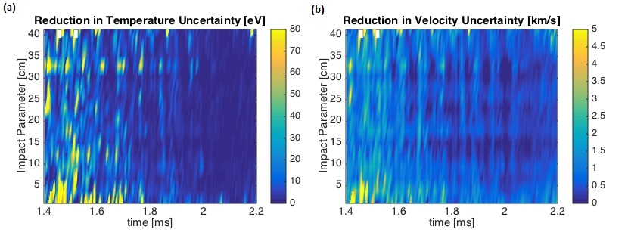
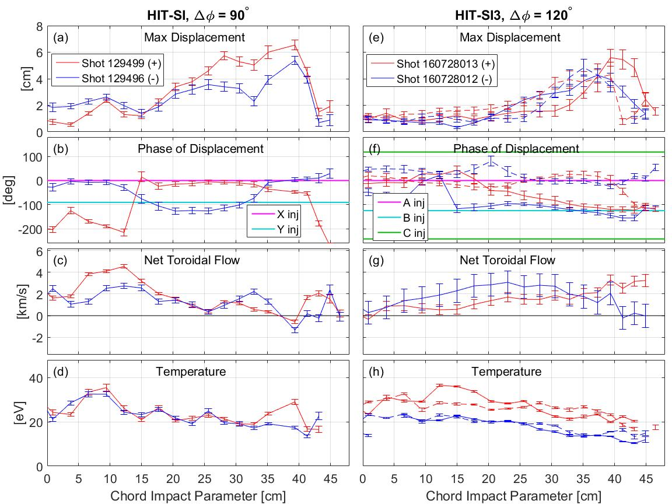
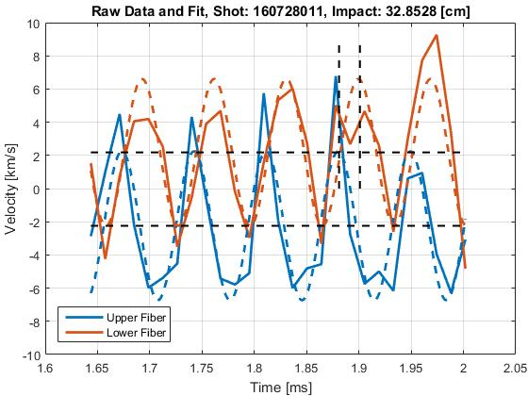
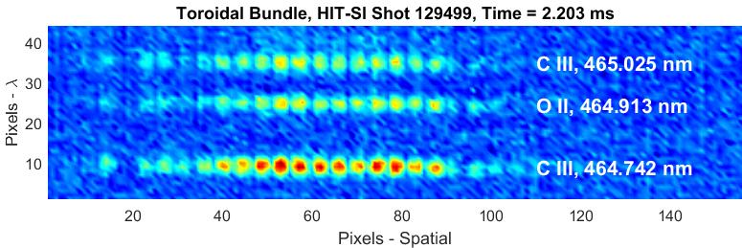
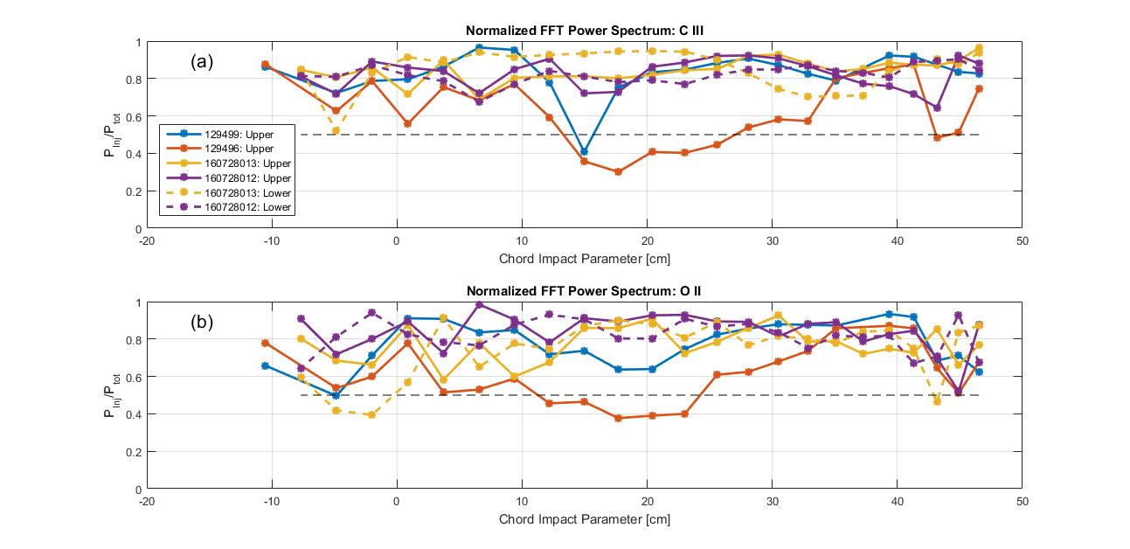
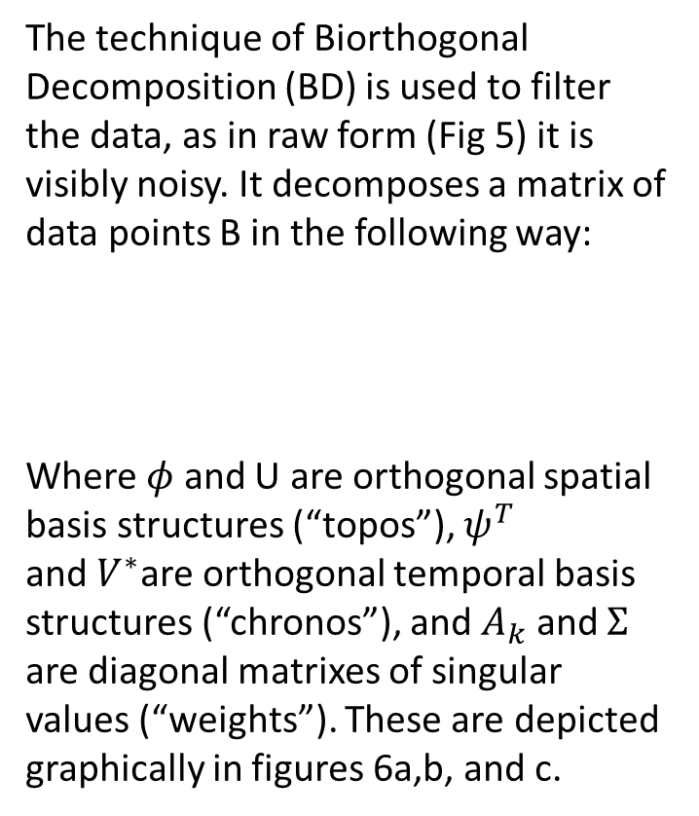
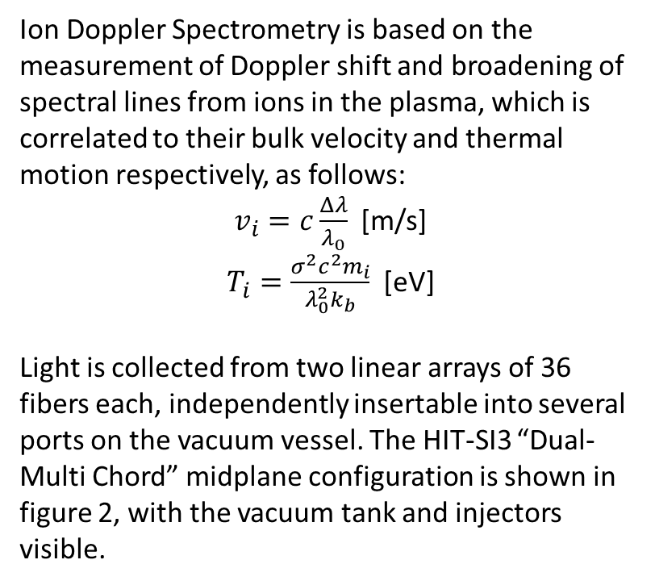
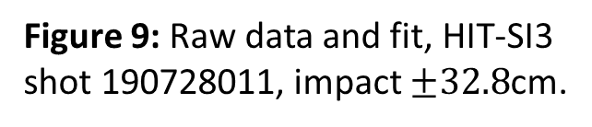
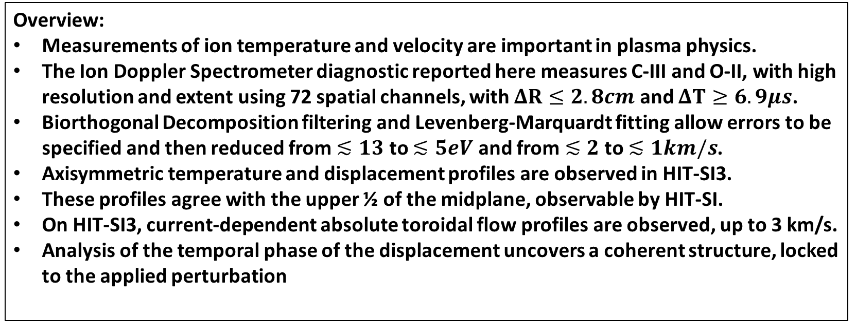
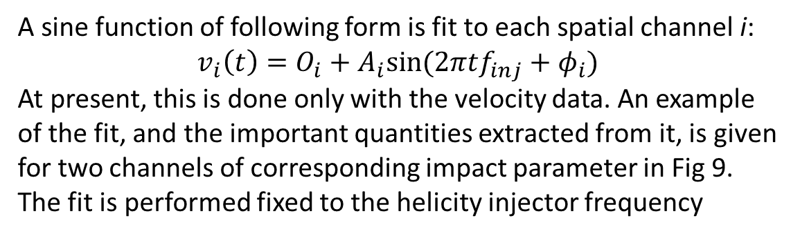
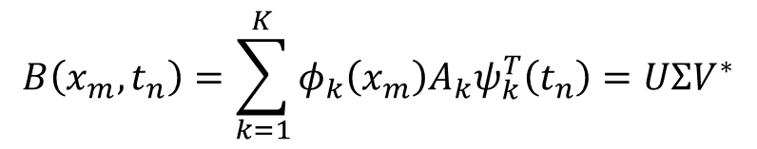
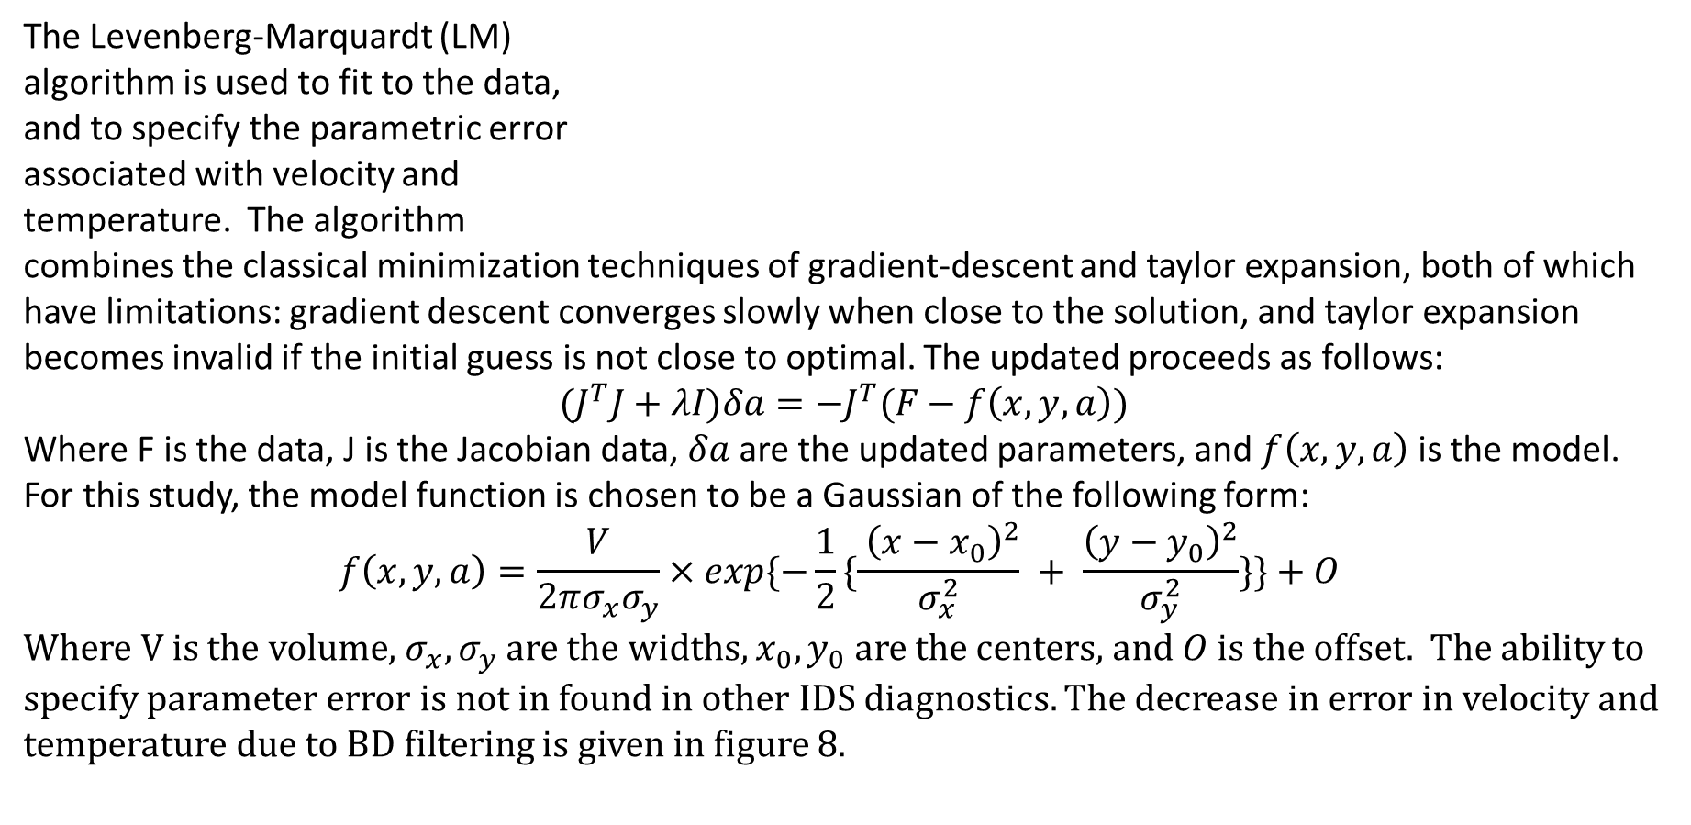
Improvements to the Ion Doppler Spectrometer Diagnostic on the HIT-SI Experiments -Rian Chandra, Aaron Hossack, Tom Jarboe, Chris Everson, and the HIT group.
Overview:
Measurements of ion temperature and velocity are important in plasma physics.
The Ion Doppler Spectrometer diagnostic reported here measures C-III and O-II, with high resolution and extent using 72 spatial channels, with $ΔR≤2.8cm$ and $ΔT≥6.9μs$.
Biorthogonal Decomposition filtering and Levenberg-Marquardt fitting allow errors to be specified and then reduced from $≲13$ to $≲5eV$ and from $≲2$ to $≲1km/s$.
Axisymmetric temperature and displacement profiles are observed in HIT-SI3.
These profiles agree with the upper ½ of the midplane, observable by HIT-SI.
On HIT-SI3, current-dependent absolute toroidal flow profiles are observed, up to 3 km/s.
Analysis of the temporal phase of the displacement uncovers a coherent structure, locked to the applied perturbation
Filtering and Fitting:
1) Biorthogonal Decomposition
The technique of Biorthogonal
Decomposition (BD) is used to filter the data, as in raw form (Fig 5) it is visibly noisy. It decomposes a matrix of data points B in the following way:
Where $φ$ and U are orthogonal spatial basis structures (“topos”), $ψ^{T}$ and$V^{∗}$are orthogonal temporal basis structures (“chronos”), and $A_{k}$ and $Σ$ are diagonal matrixes of singular values (“weights”). These are depicted graphically in figures 6a,b, and c.
$$B\left(x_{m},t_{n}\right)=\sum_{k=1}^{K}{φ_{k}\left(x_{m}\right)A_{k}ψ_{k}^{T}\left(t_{n}\right)=UΣV^{∗}}$$
The HIT-SI3 Experiment
The Helicity Injected Torus-Steady Inductive group is investigating a novel strategy for confining a plasma, for fusion energy applications. Steady-State confinement in a simply- connected “spheromak” geometry is based on the theory of Imposed Dynamo Current Drive. In brief, helical magnetic fields are injected from the “teacup-handles” in figure 1a and 1b, into the confinement volumes. These fields relax, driving a current which confines the plasma.
Figure 6a: Singular values. 6b: First four temporal basis structures. 6c: First four spatial basis structures.
Other studies have investigated these structures in of themselves, but in our case BD is used exclusively as a filtering tool, in which the data is reconstructed from the first ten “modes”, as shown in figure 7a and b. The other modes are taken to be noise, a frame of which is shown in fig 7c. The decrease in error due to BD filtering in show in Fig 8.
Figure 1a (left): HIT-SI3 vacuum tank, with helicity injectors ‘A’, ‘B’, ‘C’ shown. Figure 1b (right): HIT-SI vacuum tank, with injector ‘X’ shown.
Raw Output
Figure 11a: Raw temperature and injectors, HIT-SI3 shot 160728031.
Figure 11b: Raw velocity trace and injectors, HIT-SI shot 129499.
The velocity and temperature can be extracted from the Gaussian fit to the raw data. Two different visualization are given, for HIT-SI3 and HIT-SI, in figure 11a and 11b. In the former, color contours show a clear temperature gradient, and the oscillations at the injector frequency. In the latter, the phase-locked nature of the velocity becomes noticeable across impact parameters.
The Ion Doppler Spectrometer (IDS)
Figure 7a: CCD before BD filtering, HIT-SI shot 129499. 7b: CCD after BD filtering, same timepoint. 7c: All discarded modes, summed together at one timepoint.
Ion Doppler Spectrometry is based on the measurement of Doppler shift and broadening of spectral lines from ions in the plasma, which is correlated to their bulk velocity and thermal motion respectively, as follows:
$v_{i}=c\frac{Δλ}{λ_{0}}$ [m/s]
$T_{i}=\frac{σ^{2}c^{2}m_{i}}{λ_{0}^{2}k_{b}}$ [eV]
Light is collected from two linear arrays of 36 fibers each, independently insertable into several ports on the vacuum vessel. The HIT-SI3 “Dual-Multi Chord” midplane configuration is shown in figure 2, with the vacuum tank and injectors visible.
2) Levenberg-Marquardt
The Levenberg-Marquardt (LM) algorithm is used to fit to the data, and to specify the parametric error associated with velocity and temperature. The algorithm combines the classical minimization techniques of gradient-descent and taylor expansion, both of which have limitations: gradient descent converges slowly when close to the solution, and taylor expansion becomes invalid if the initial guess is not close to optimal. The updated proceeds as follows:
$${(J}^{T}J+λI)δa=−J^{T}(F−f\left(x,y,a\right))$$
Where F is the data, J is the Jacobian data, $δa$ are the updated parameters, and $f\left(x,y,a\right)$is the model. For this study, the model function is chosen to be a Gaussian of the following form: $$f\left(x,y,a\right)=\frac{V}{2πσ_{x}σ_{y}}×exp\{−\frac{1}{2}\{\frac{ {\left(x−x_{0}\right)}^{2}}{σ_{x}^{2}} + \frac{{\left(y−y_{0}\right)}^{2}}{σ_{y}^{2}}\}\}+O$$
Where V is the volume, $σ_{x}, σ_{y}$ are the widths, $x_{0}, y_{0}$ are the centers, and $O$ is the offset. The ability to specify parameter error is not in found in other IDS diagnostics. The decrease in error in velocity and temperature due to BD filtering is given in figure 8.
Figure 3: HIT-SI3 midplane fibers
Figure 8: Decrease in LM measured parameter error due to BD filtering, HIT-SI shot 129499
On HIT-SI, only the upper midplane port was installed. Data can also be collected from poloidal and radial ports, but these are not presented here.
The spectrometer itself is a one meter focal length Czerny-Turner ruled grating monocrometer (Ritsu Ohyo Kogaku model MC-100N), with 18000 lines/mm. The fibers are fused-silica. The hardware is pictured in Fig 3.
Diffraction Grating
Camera
Fiber bundle
Spectrometer
Conclusions:
3) Sine Fit
Collimating lens
An Ion Doppler Spectrometer has been constructed with a wider spatial range, and higher spatiotemporal resolution than described previously.
Fitting and filtering specify and reduce error in a novel manner.
Persistent, axisymmetric profiles in temperature and displacement are found in HIT-SI3 in C-III (Fig 12a(e,h) and O-II 12b(e,h).
These profiles agree with the upper ½ HIT-SI midplane (Fig 12a(a,d) and 12b(a,d).
The flat phase region
A sine function of following form is fit to each spatial channel i:
$$v_{i}\left(t\right)=O_{i}+A_{i}sin⁡(2πtf_{inj}+φ_{i})$$
At present, this is done only with the velocity data. An example of the fit, and the important quantities extracted from it, is given for two channels of corresponding impact parameter in Fig 9. The fit is performed fixed to the helicity injector frequency
Figure 4: IDS spectrometer with fibers, lenses, and camera.
Raw Data Collection
Data is collected by a Phantom v710 fast camera, optically coupled to the spectrometer. Figure 5 shows a typical view from the CCD, taken from HIT-SI. Typically the spectrometer is tuned to Carbon – III or Oxygen – II, at 464.7nm and 464.9nm respectively. Data is acquired efficiently after each discharge using a Matlab script written with the camera’s accompanying SDK.
Figure 9: Raw data and fit, HIT-SI3 shot 190728011, impact $±32.8$cm.
A Fast Fourier Transform is used to generate an initial guess for the sine fit, and to confirm that a single frequency reconstruction is valid. Figure 10a and 10b. We find that the reconstruction is valid over the applied time window, as for almost all impact parameters, and for both ion species, the injector frequency is the dominant Fourier component.
Figure 5: Typical CCD image, HIT-SI shot 129499, 2.2ms
Figure 12a: Comparison of toroidal current directions, all analyzed quantities , HIT-SI (a-d) and HIT-SI3 (e-h), 464.7nm C-III line.
Figure 12b: Comparison of toroidal current directions, all analyzed quantities, HIT-SI (a-d) and HIT-SI3 (e-h), 464.9nm O-II line.
Figure 10: Percentage of FFT power spectrum contained in the helicity injection frequency and its four higher harmonics, for all analyzed shots in C III (a) and O II (b).

